Slide 1
Calculating Family Expenses Using Service Now
SlideMake.com

Slide 2

Introduction to Calculating Family Expenses
Understanding family expenses is essential for effective financial management.
ServiceNow offers tools to streamline the tracking and calculation process.
This presentation outlines how to utilize ServiceNow for family expense management.
Notes:
Image source: https://thumbs.dreamstime.com

Slide 3
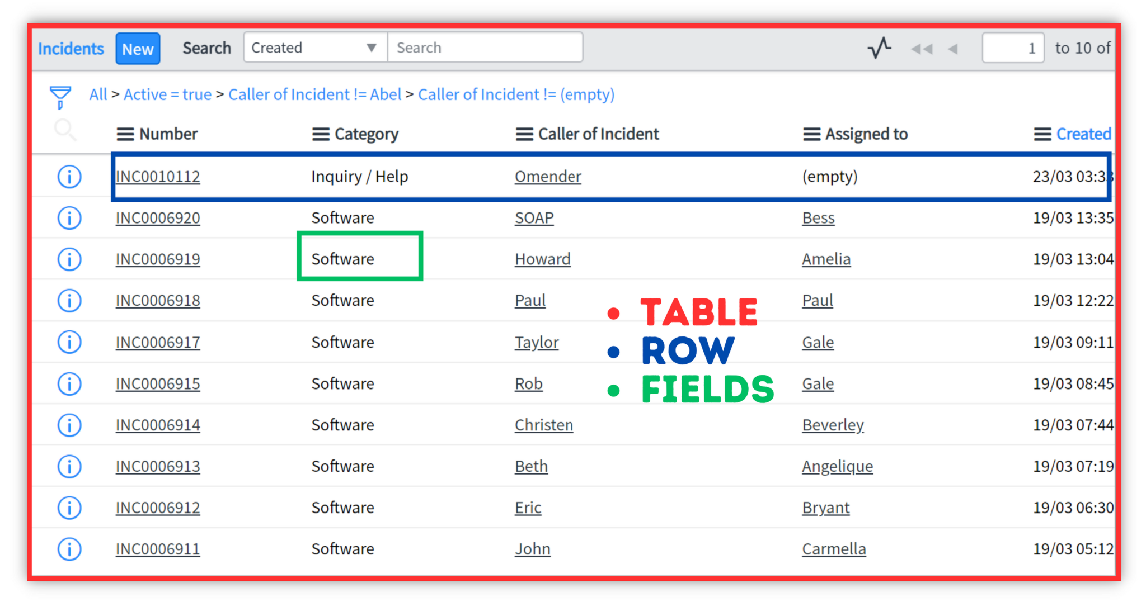
Overview of ServiceNow Platform
ServiceNow is a cloud-based platform designed for workflow automation and data management.
It provides customizable modules suitable for personal and family financial tracking.
Its user-friendly interface makes it accessible for users with varying technical skills.
Notes:
Image source: https://servicenowspectaculars.com

Slide 4

Setting Up Family Expense Categories
Create specific categories such as housing, food, transportation, and entertainment for clarity.
Use ServiceNow's configuration options to define and organize these expense categories.
Proper categorization helps in detailed analysis and budgeting.
Notes:
Image source: https://www.runviably.com

Slide 5
Inputting Family Expenses
Enter expenses regularly to ensure accurate tracking of financial activity.
Utilize forms and templates within ServiceNow to standardize data entry.
Encourage all family members to contribute for comprehensive expense recording.
Notes:
Image source: https://thumbs.dreamstime.com

Slide 6
Automating Expense Collection
Use ServiceNow workflows to automate recurring expense entries like bills and subscriptions.
Integrate with bank accounts or financial apps for real-time data import if possible.
Automation reduces manual effort and minimizes data entry errors.
Notes:
Image source: https://blogs.servicenow.com

Slide 7

Analyzing Expenses and Spending Patterns
Generate reports and dashboards to visualize spending trends over time.
Identify areas where expenses can be reduced or optimized.
Use insights to inform future budgeting and financial planning.
Notes:
Image source: https://img.freepik.com

Slide 8
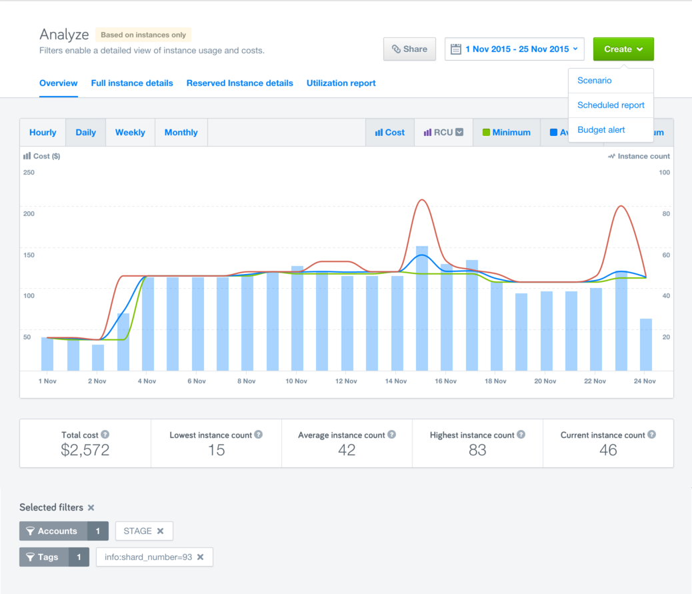
Setting Budget Goals and Alerts
Define monthly or annual budget limits for each expense category.
Configure ServiceNow alerts to notify when spending approaches or exceeds set limits.
Monitoring helps maintain financial discipline and avoid overspending.
Notes:
Image source: https://docs.rightscale.com

Slide 9

Collaborating and Sharing Financial Data
Share expense reports with family members to promote transparency.
Use ServiceNow's collaboration tools for discussions and decision-making.
Collective input enhances financial strategies and accountability.
Notes:
Image source: https://img.freepik.com

Slide 10
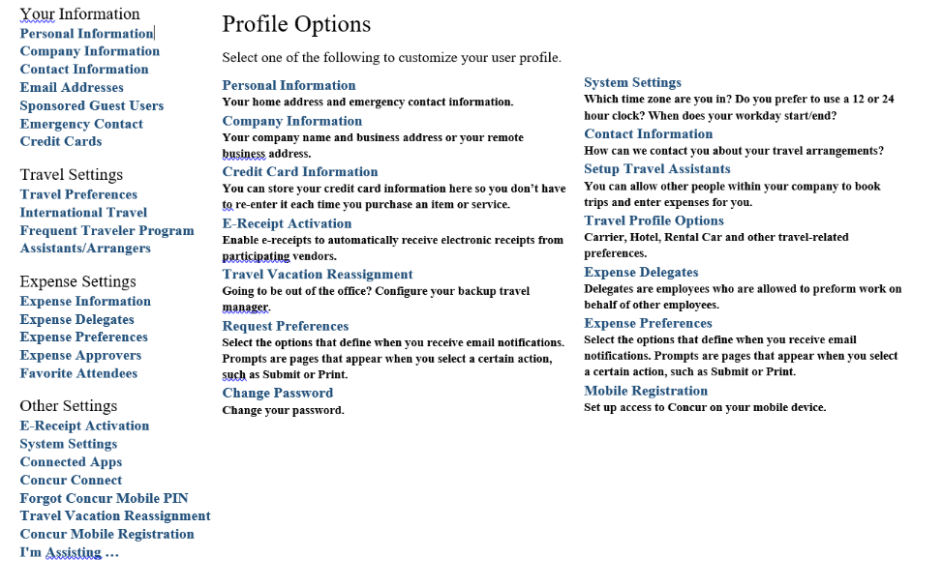
Maintaining and Updating Expense Data
Regularly review and update expense entries for accuracy.
Adjust categories and budgets as family financial situations change.
Consistent maintenance ensures ongoing usefulness of the expense management system.
Notes:
Image source: https://ibuy.gwu.edu

Slide 11
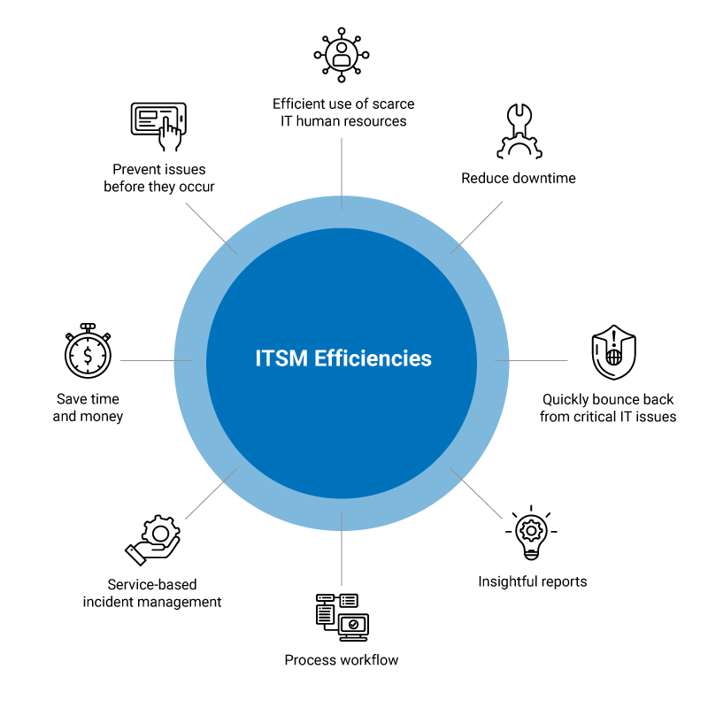
Conclusion and Benefits of Using ServiceNow
Implementing ServiceNow simplifies the process of managing family expenses.
It provides valuable insights to support better financial decisions.
Overall, it promotes financial stability and transparency within the family.
Notes:
Image source: https://arcticit.com

